Slide 1


How the perceived prevalence of sexual harassment in one’s neighborhood associated with subjective security, and is this association stronger among women than among men in the context of Singapore and Malaysia?
Presented by The Husky Group

Slide 2



Why do we care about sexual harassment and security？
  71% changed their travel routes or routines due to fear of sexual harassment.
  68% did not feel safe driving alone at night.
（Cent-GPS & AWAM, 2021）
  This made us interested not only in actual experiences of sexual harassment, but also in how common people perceive it to be in their neighborhood, and whether this perception is related to how secure they feel.

Slide 3
Why does gender matter?
  Gendered geography of fear (Valentine, 1989)
  Women generally report higher fear and perceived vulnerability
  Sexual harassment is strongly gendered
Why Singapore & Malaysia?
  Geographically close
  Shared historical and cultural similarity
  Different socioeconomic and institutional contexts
  A cleaner comparison
Previous studies have examined sexual harassment, fear, and subjective security separately. However, less is known about whether perceived sexual harassment lowers subjective security, especially among women and across countries.

Slide 4
Research question:
How is the perceived prevalence of sexual harassment in one’s neighborhood associated with subjective security, and is this association stronger among women than among men in the context of Singapore and Malaysia?

Slide 5
Hypothesis:
Hypothesis 1: Main association
  H0₁: Perceived prevalence of sexual harassment in one’s neighborhood is not associated with subjective security.
  H1₁: Higher perceived prevalence of sexual harassment in one’s neighborhood is associated with lower subjective security.
Hypothesis 2: Gender difference
  H0₂: The association between perceived sexual harassment and subjective security does not differ by gender.
  H1₂: The association between perceived sexual harassment and subjective security is stronger among women than among men.
Hypothesis 3: Country difference
  H0₃: The gender difference in the association between perceived sexual harassment and subjective security is the same in Singapore and Malaysia.
  H1₃: The gender difference in this association varies between Singapore and Malaysia.

Slide 6







Data Chosen
Dataset: Wave 7 of the World Values Survey
Sample: The Singapore 2020 and Malaysia 2018 data, raw data contain 2012 Singapore respondents and 1313 Malaysian respondents
Variables:
  Subjective security
  Sexual harrassment
  Gender
  Age
  Education
  Household income
  Employment status
  Marital status
  Victim self
  Victim family

Slide 7
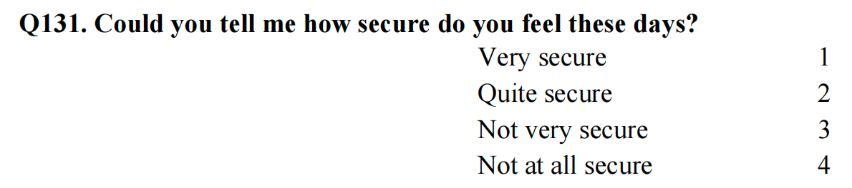
Dependent Variable:
Subjective security
  Measured using Q131 (“How secure do you feel these days?”)
  Ordinal Variable
  Note: Reverse-coded as security_r
  Higher scores = greater subjective security

Slide 8
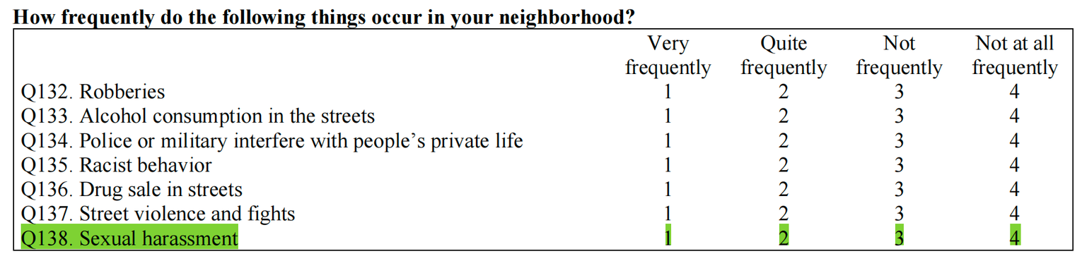
Independent Variable:
Perceived prevalence of sexual harassment
  Measured using Q138 (“How frequently does sexual harassment occur in your neighborhood?”)
  Ordinal Variable
  Note: Reverse-coded as harassment_r
  Higher scores = more frequent perceived sexual harassment.

Slide 9
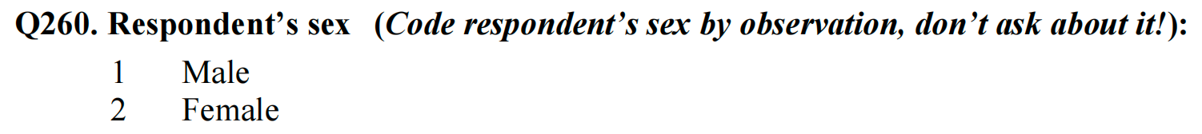
Moderator: Gender
  Gender, binary variable, men is the reference group (coded 0)

Slide 10
Control Variables:
  Age, continuous variable, measured in years
  Education, ordinal variable, measured by highest educational level attained
  Household income, ordinal variable, measured on a 10-point income scale from lowest to highest income group
  Employment status, binary variable, unemployment is the reference group (coded 0)
  Marital status, binary variable, unmarried is the reference group (coded 0)
  Personal crime victimisation, binary variable, no victim is the reference group (coded 0)
  Family crime victimisation, binary variable, no victim is the reference group (coded 0)

Slide 11
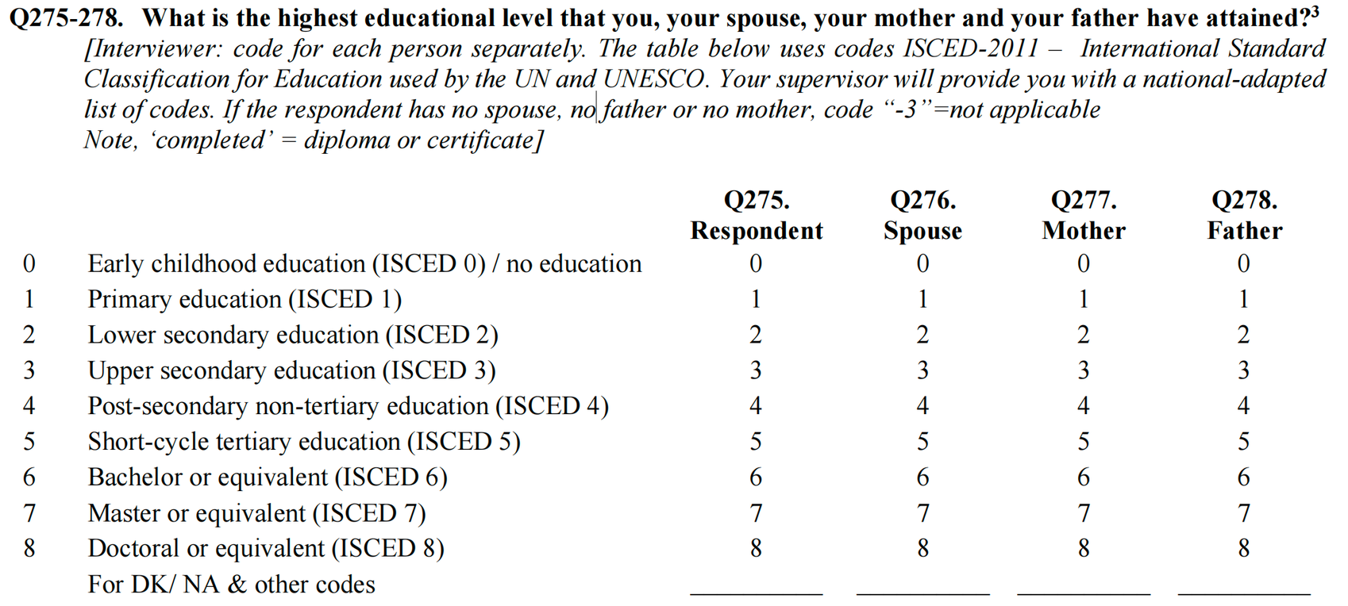
Control Variables:

Slide 12
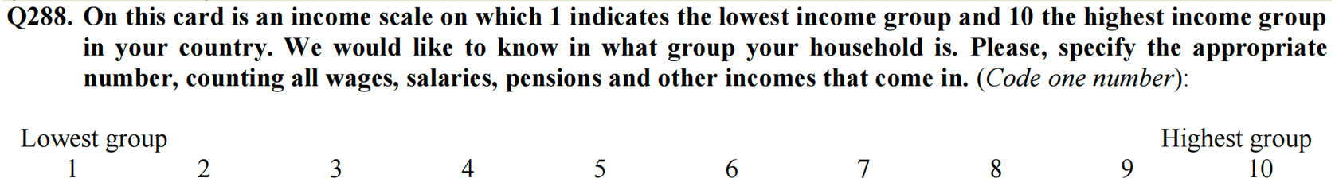
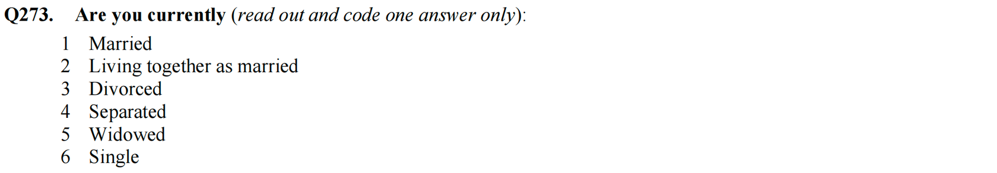
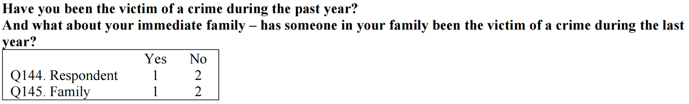
Control Variables:

Slide 13
OLS Model Formula

Slide 14

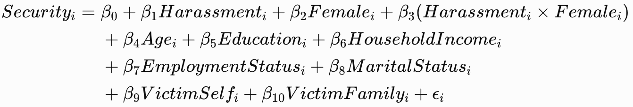
Model1
Model2
Model3

Slide 15








Singapore

Slide 16
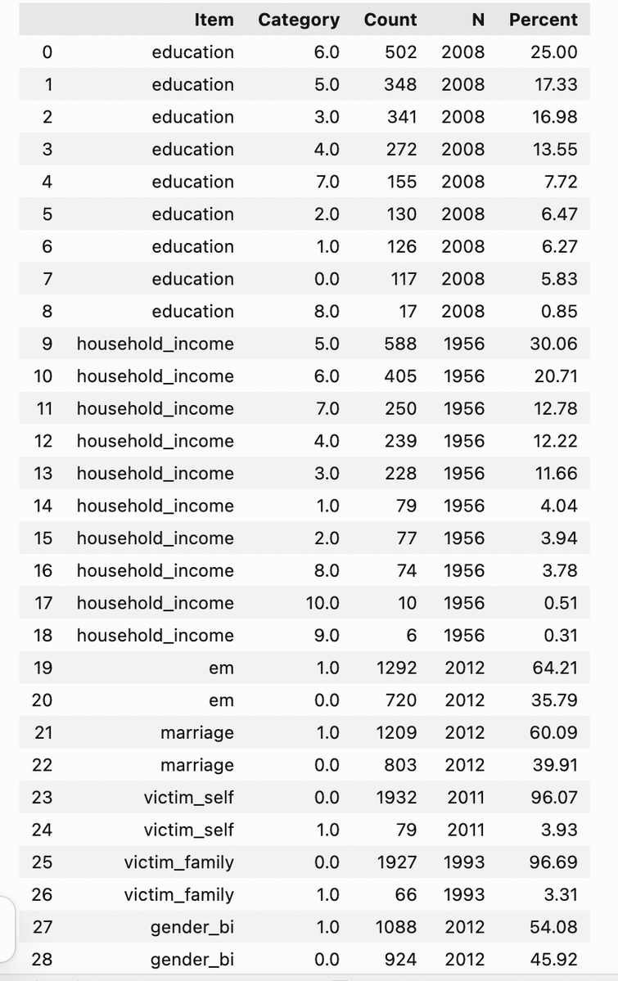

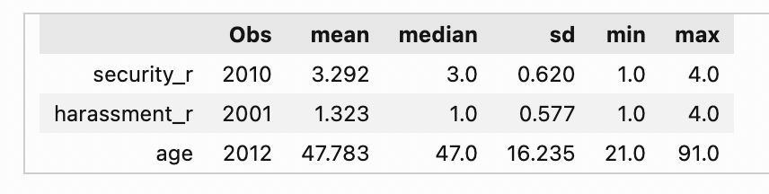
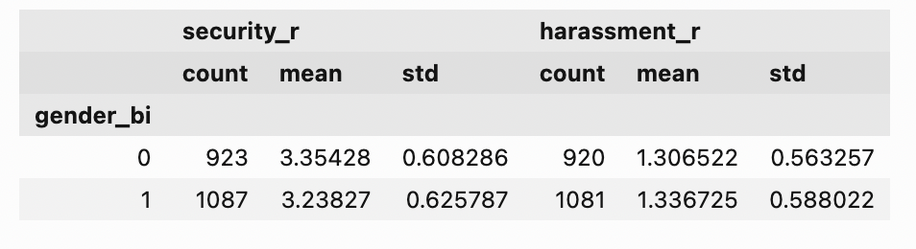
Descriptive statistics— Singapore
  Sample size：N = 2,012
  Gender: 54.08% women，45.92% men

Slide 17
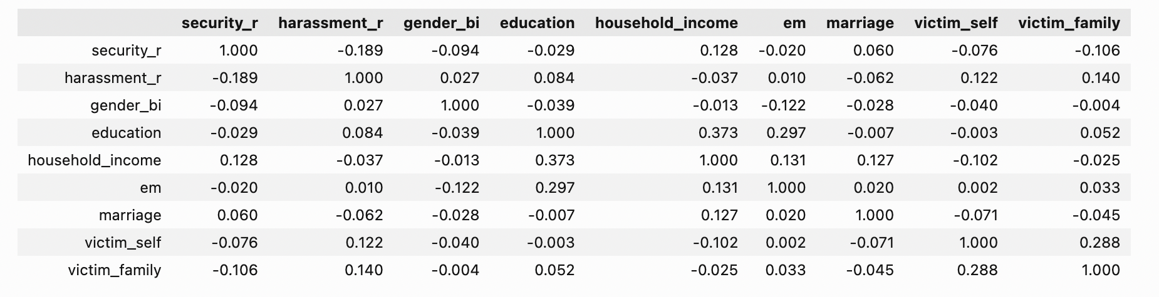
Correlation — Singapore
  harassment–security relationship is relatively weak, but statistically significant

Slide 18
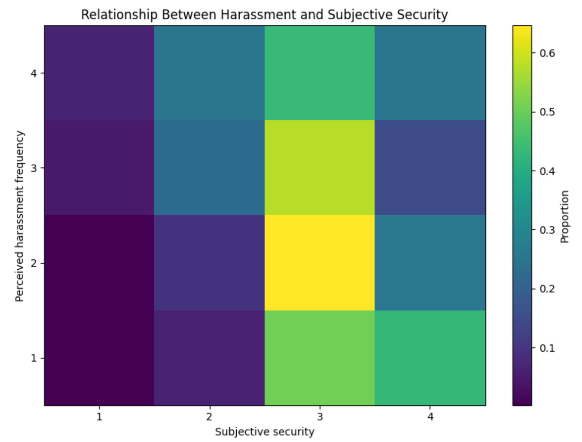
Data Visualization
Heat map
  Darker colors indicate lower proportions, while colors closer to yellow indicate higher proportions.
↓perceived frequency
↑subjective security score
  A negative association between perceived harassment frequency and subjective security.

Slide 19
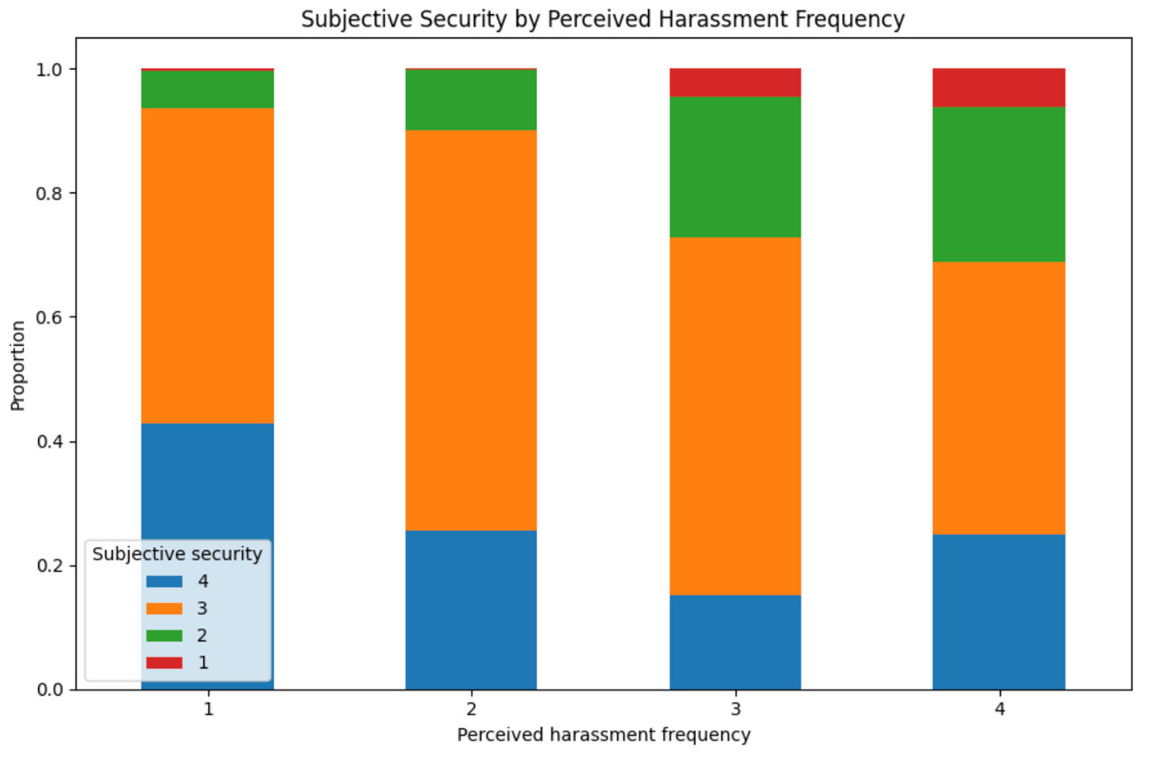
Data Visualization
Stacked bar chart
  The colors represent different levels of subjective security, from 1 (lowest security) to 4 (highest security).
  Similar to the heatmap, the chart shows that respondents who perceive sexual harassment as more frequent tend to report higher subjective security scores.

Slide 20
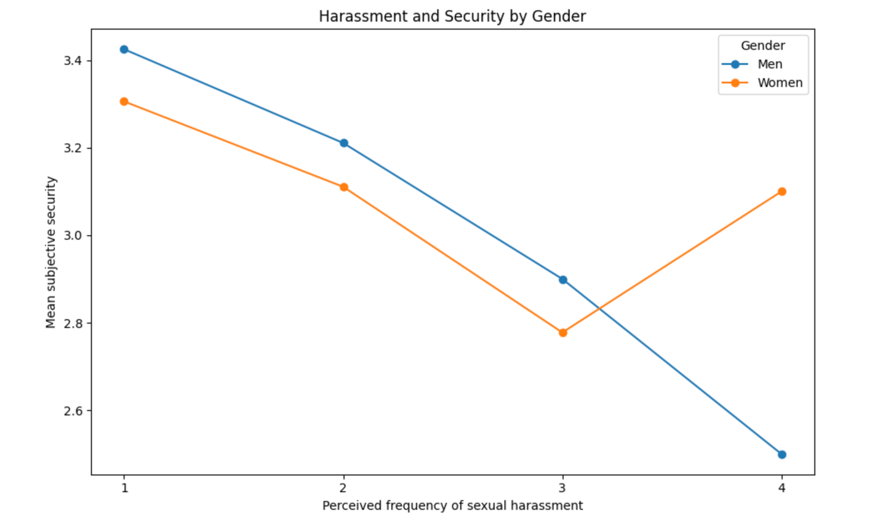
Data Visualization
Gender Difference
  Women generally report lower subjective security than men.
  Subjective security tends to decline as perceived harassment frequency increases.
  However, Category 4 is based on a small sample (n = 16), so the gender difference at this level should be interpreted carefully.

Slide 21
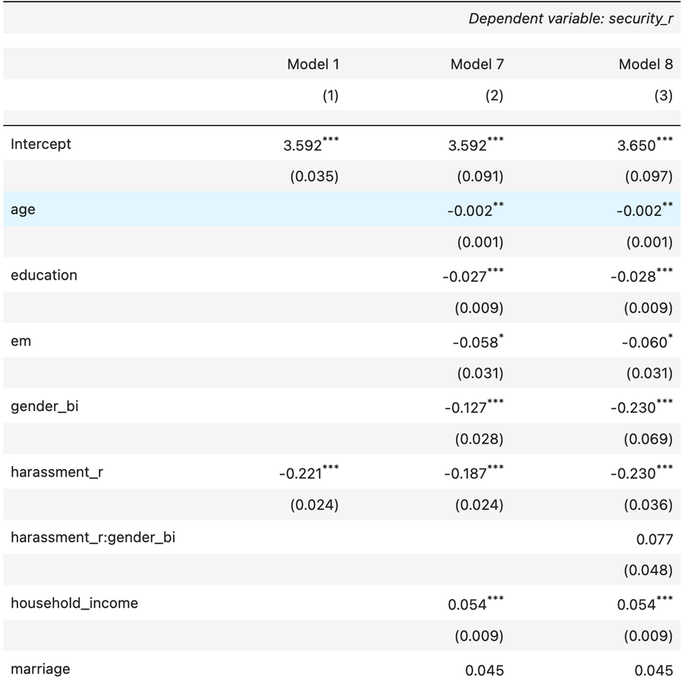
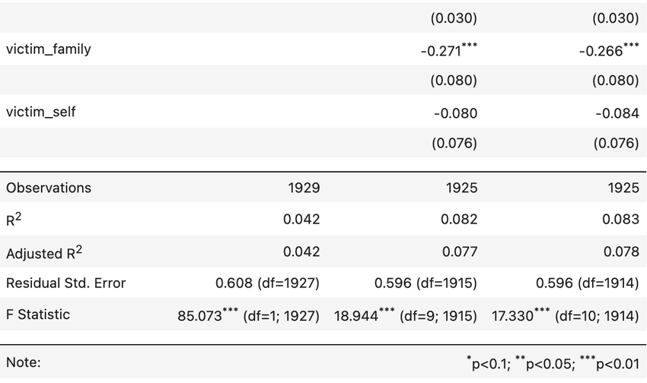
Regression result
  For Model 1, perceived harassment is significantly associated with subjective security (β = −0.221, p < 0.01).
  The relationship remains significant even after adding the control variables (β = −0.190, p < 0.01).
  Model 8 shows that the interaction between harassment and gender is positive but not significant at the 5% level.
  R square increases from 0.042 to 0.081 after adding the controls, but changes only slightly to 0.082 after adding the interaction. A similar pattern can be seen for adjusted R square.

Slide 22
Malaysia

Slide 23

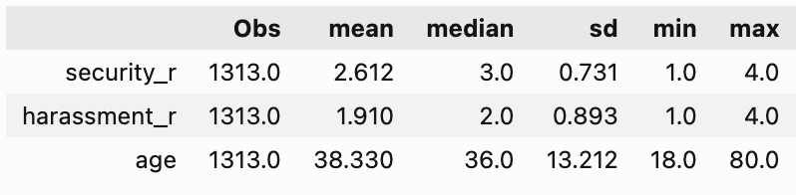
Descriptive statistic – Numeric
  Subjective security: Mean = 2.61
⟶ Respondents were, on average, between “not very secure” and “quite secure”, closer to “quite secure”.
  Perceived sexual harassment: Mean = 1.91
⟶ Respondents generally perceived sexual harassment as occurring between “not at all frequently” and “not frequently”, closer to “not frequently”.
  Mean age: 38.3 years.

Slide 24
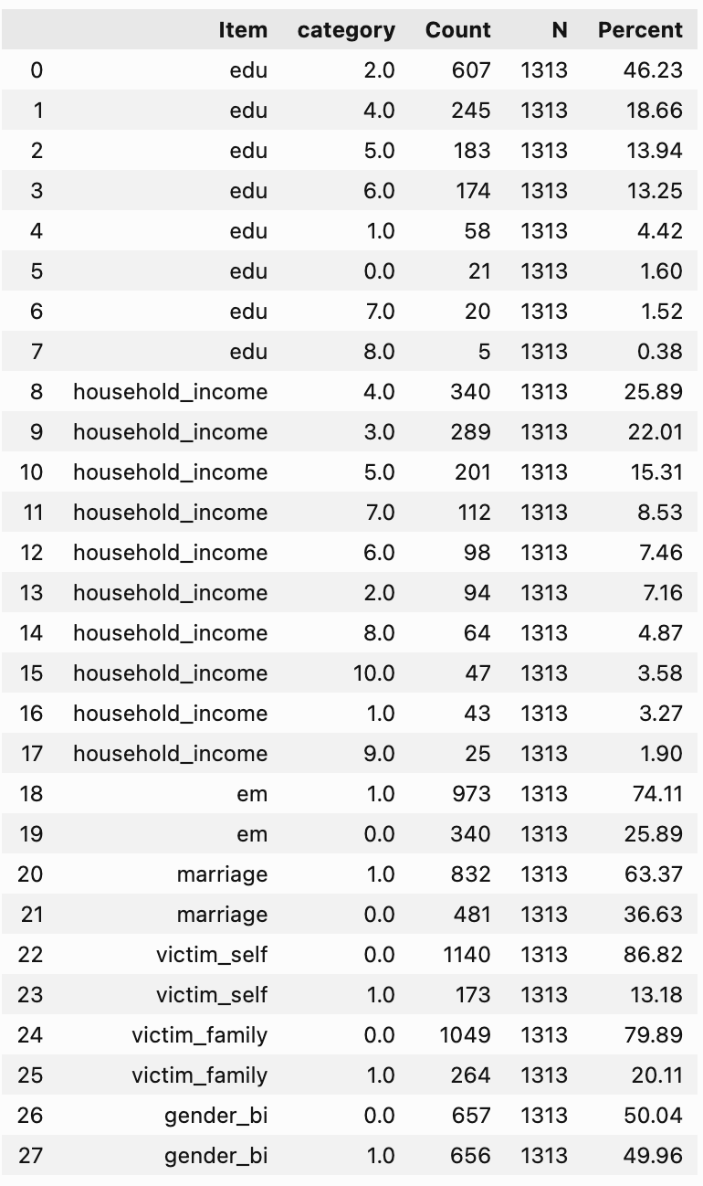
Descriptive statistic – Categorical
  The sample is nearly evenly split by gender (50.0% male; 50.0% female).
  74.1% are employed and 63.4% are married.
  13.2% report personal crime victimisation, while 20.1% report victimisation of a family member.
  Education and household income show variation across categories.

Slide 25
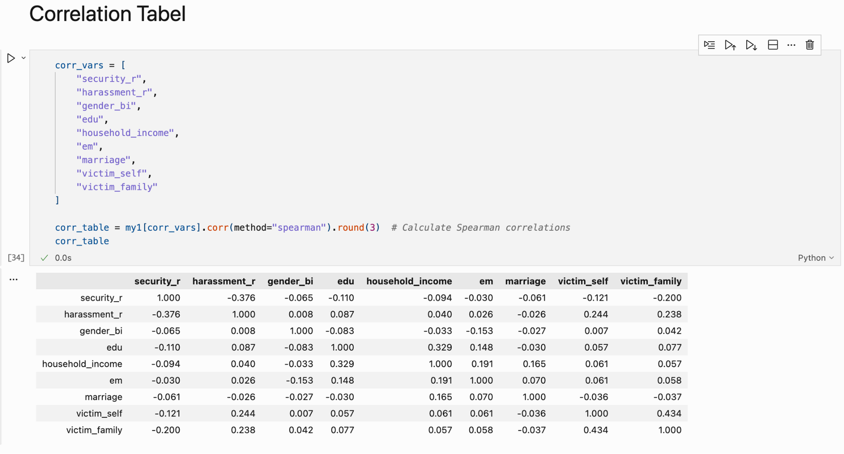
Correlation Table
  Security & harassment: moderate negative correlation (r_s = -0.376)
  Gender: very weak bivariate correlations with both key variables
  Controls: no very high pairwise correlations; highest is between personal and family victimisation (r_s = 0.434)

Slide 26
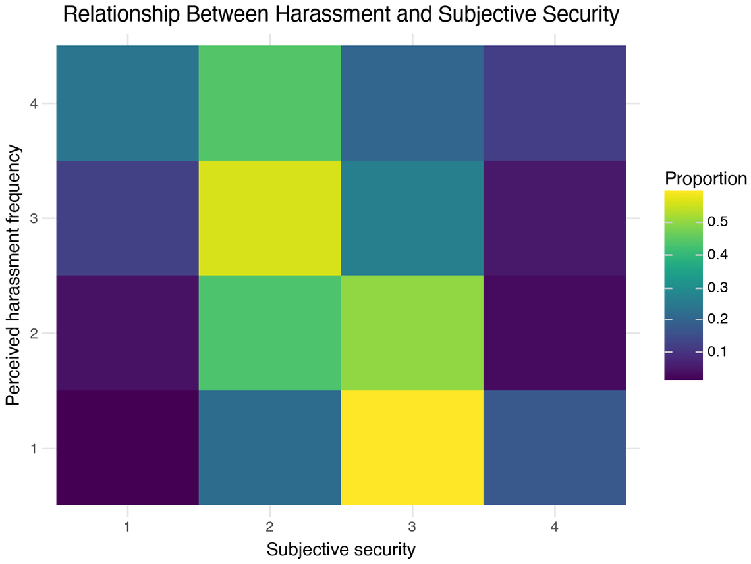
Data Visualization
Heat map
  Each colour block represents the proportion of people at each security level within each harassment frequency group
  Findings: As perceived harassment becomes more frequent, subjective security tends to decrease

Slide 27
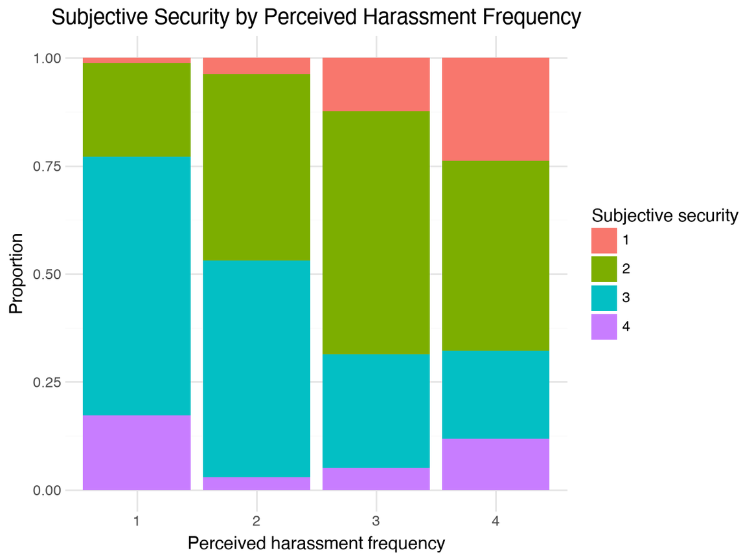
Data Visualization
Stacked bar chart
  When harassment frequency = 1, security = 4 has the largest proportion → many respondents feel safe
  When harassment frequency = 4, security = 1 has the largest proportion → many respondents feel unsafe

Slide 28
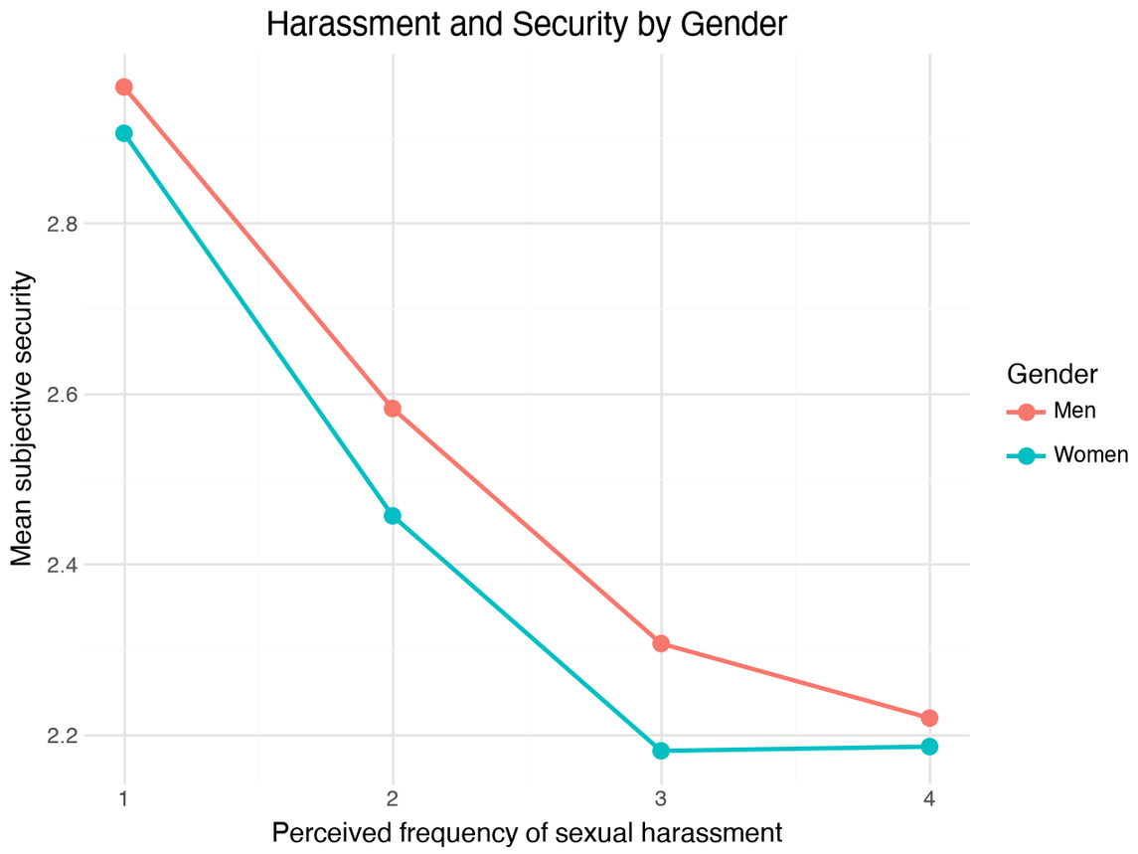
Data Visualization
Gender difference
  For both men and women, as perceived frequency of sexual harassment becomes more frequent, their subjective security becomes lower
  However, women generally reports lower subjective security than men

Slide 29
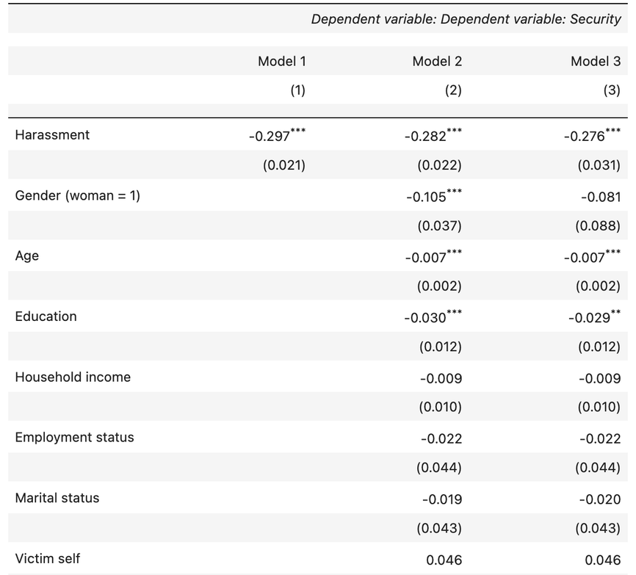
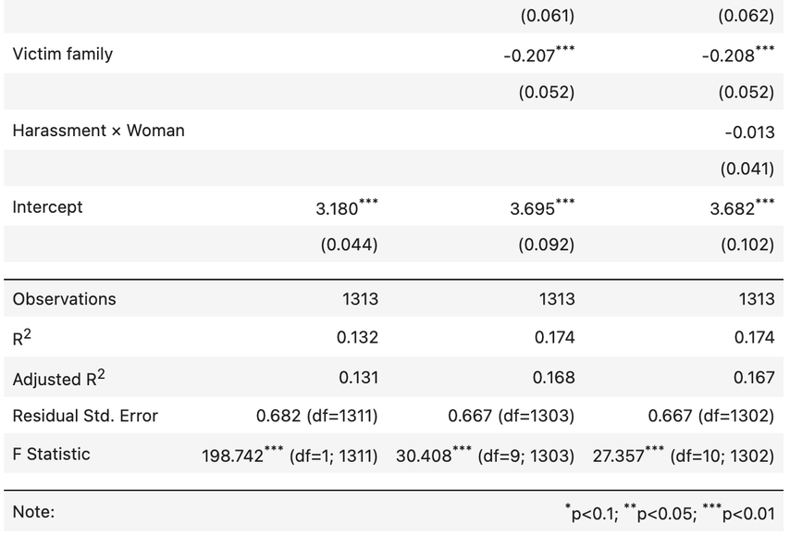
Regression - Malaysia
  There is no evidence that there is an interaction effect between harrassment and gender.
  According to the value of adjusted R-squared, model 2 is the best model among the three models.
  In model2, moving up by one category in perceived harassment frequency is associated with 0.282 points decrease in the subjective security score, ceteris paribus (p<0.01).
  Gender, age, education and victim family are also associated with subjective security in model2.

Slide 30
Singapore vs
Malaysia

Slide 31
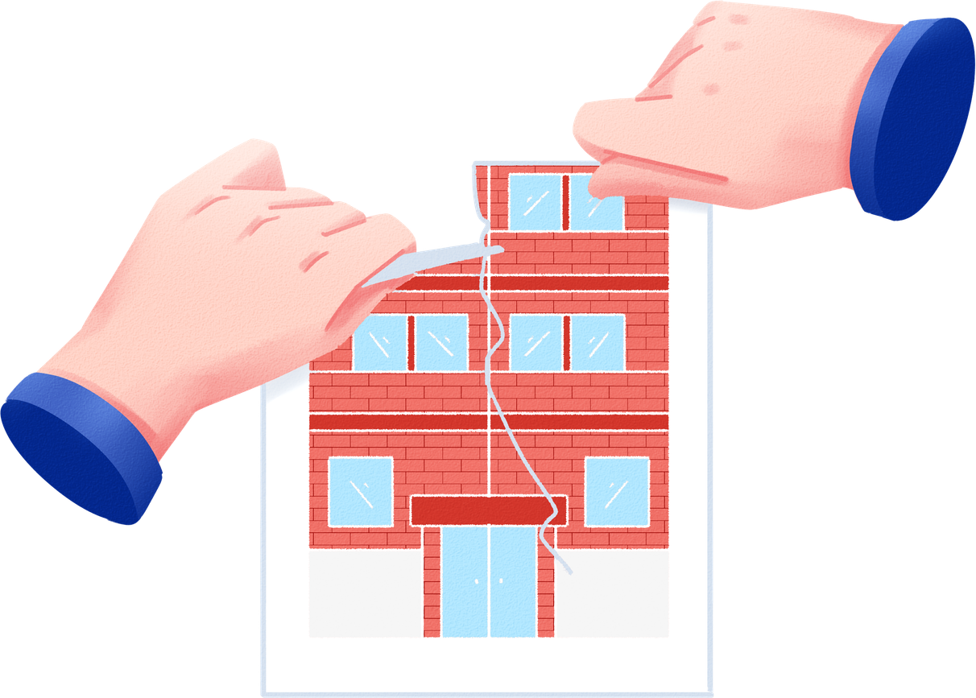
Singapore vs Malaysia comparison
Similarities
  Both countries show a significant negative relationship between perceived harassment and subjective security.
  The relationship remains significant after adding controls.
  The gender interaction is not significant at the 5% level in either country.
Differences
  The negative association appears stronger in Malaysia (β ≈ −0.29) than in Singapore (β ≈ −0.22).
  Adding the interaction changes Adjusted R² only slightly (+0.001 in Singapore vs −0.001 in Malaysia).
Overall: Despite some differences in strength, the main pattern is consistent across both countries.

Slide 32
Next: Examine the Hypothesis
A brief glance at the current regression results (at the 5% significance level):
  Significant negative correlation between perceived prevalence of sexual harassment and subjective security level
  Insignificant moderating effect of gender
  Comparison between Singapore and Malaysia to be done later

Slide 33
Limitations & Future Research
Limitations
  Cross-sectional data cannot establish causality or causal direction.
  Both key variables are 4-point ordinal measures but are treated as continuous in the regression, assuming equal distances between response categories.
  Unobserved contextual factors, such as gender norms and institutional effectiveness, may confound the association.
Future Research
  Extend the analysis to a larger cross-national sample using multilevel models.
    Incorporate country-level measures of gender norms, violence against women, institutional support, and overall safety.
    Examine whether these contextual factors moderate the association between perceived sexual harassment and subjective security.
  Future analyses could test robustness using ordered logistic models or models more suitable for ordinal variables

Slide 34
Thank You

